Slide 1

MAULANA AZAD
NATIONAL INSTITUTE OF TECHNOLOGY
BHOPAL, INDIA, 462003
DEPARTMENT OF COMPUTER SCIENCE & ENGINEERING
TEAM MEMBERS
Archit Badola | 201112278
Shubham Singh | 201112251
Saurav Pawar | 201112253
Prabhudeba Nath | 201112203
FACULTY
Project Mentor | Dr. Vaibhav Soni
Project Expert | Dr. Vijay Bhaskar Semwal

Slide 2
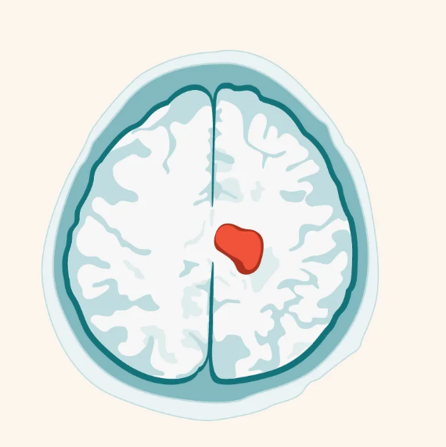
Brain Tumor Segmentation Using
Deep Learning Approach

Slide 3
Brain Tumor Segmentation
Brain tumors are abnormal growths of cells that develops within the brain tissue.
Segmentation is the process of identifying and delineating the boundaries of a tumor within a medical image of the brain.
It is important because it can help clinicians better understand the size, shape, and location of a tumor.
Accurate segmentation helps with the assessment of treatment response, by enabling the detection of changes in tumor volume or shape over time.
It can be performed using a variety of techniques, ranging from manual segmentation to fully automated algorithms.

Slide 4
Why Machine Learning?
Accurate and precise segmentation of brain tumors is crucial for diagnosis and treatment planning.
Manual segmentation of brain tumors is time-consuming and prone to inter- and intra-observer variability.
Machine learning algorithms can automate and speed up the segmentation process while minimizing variability.
Machine learning algorithms can be trained on large datasets to identify subtle features that may be missed by human observers.
By using machine learning, researchers can potentially improve the accuracy and consistency of brain tumor segmentation.

Slide 5
PROBLEM STATEMENT
The problem addressed in this project is the accurate segmentation of brain tumors from magnetic resonance imaging (MRI) scans using deep learning techniques.
Deep learning-based methods, such as the UNet and ResUNet architectures, have shown promising results in accurately segmenting brain tumors from MRI scans.
In this project, we aim to compare the performance of two deep learning architectures, UNet and ResUNet, in brain tumor segmentation tasks using two different datasets, BraTS 2020 and LGG-MRI.

Slide 6
DATASET USED:
BraTS 2020 dataset
It includes four MRI modalities: T1-weighted, T1-weighted contrast-enhanced, T2-weighted, and FLAIR.
A training set and a validation set. The training set contains MRI scans from 369 patients, while the validation set contains MRI scans from 125 patients.
Each MRI scan has a corresponding manual segmentation of the tumor regions performed by medical experts.
LGG-MRI dataset
It is a publicly available dataset of MRI scans of brain tumors.
The dataset contains preoperative MRI scans of 110 patients along with segmentation masks for the tumors.
The images were acquired using three different MRI protocols: T1-weighted, T1-weighted with contrast enhancement, and T2-weighted.

Slide 7
Research Gaps:
The proposed models in the papers need to be tested on a large scale datasets that include different ages to increase its portability and extend it in other medical applications.
Less work has been done with 3D MRIs for classification of brain tumor as the size of 3D MRIs dataset are large and there is lack of extensive studies.
Different combination of parameters and layers must be tested to check best suited models.

Slide 8
Model 1: UNET ARCHITECTURE
The 3D UNet model has an encoder and decoder like the 2D version, but it works on 3D volumes instead of 2D images.
The encoder reduces spatial dimensions and increases feature maps through convolution and pooling.
The decoder increases spatial dimensions and reduces feature maps through upsampling and convolution.
Used BraTS2020 Dataset, 258 MRIs for training and 86 for validation of model.
We ran 75 epochs on the dataset.
Batch Size: 16
Learning Rate: 0.0001

Slide 9
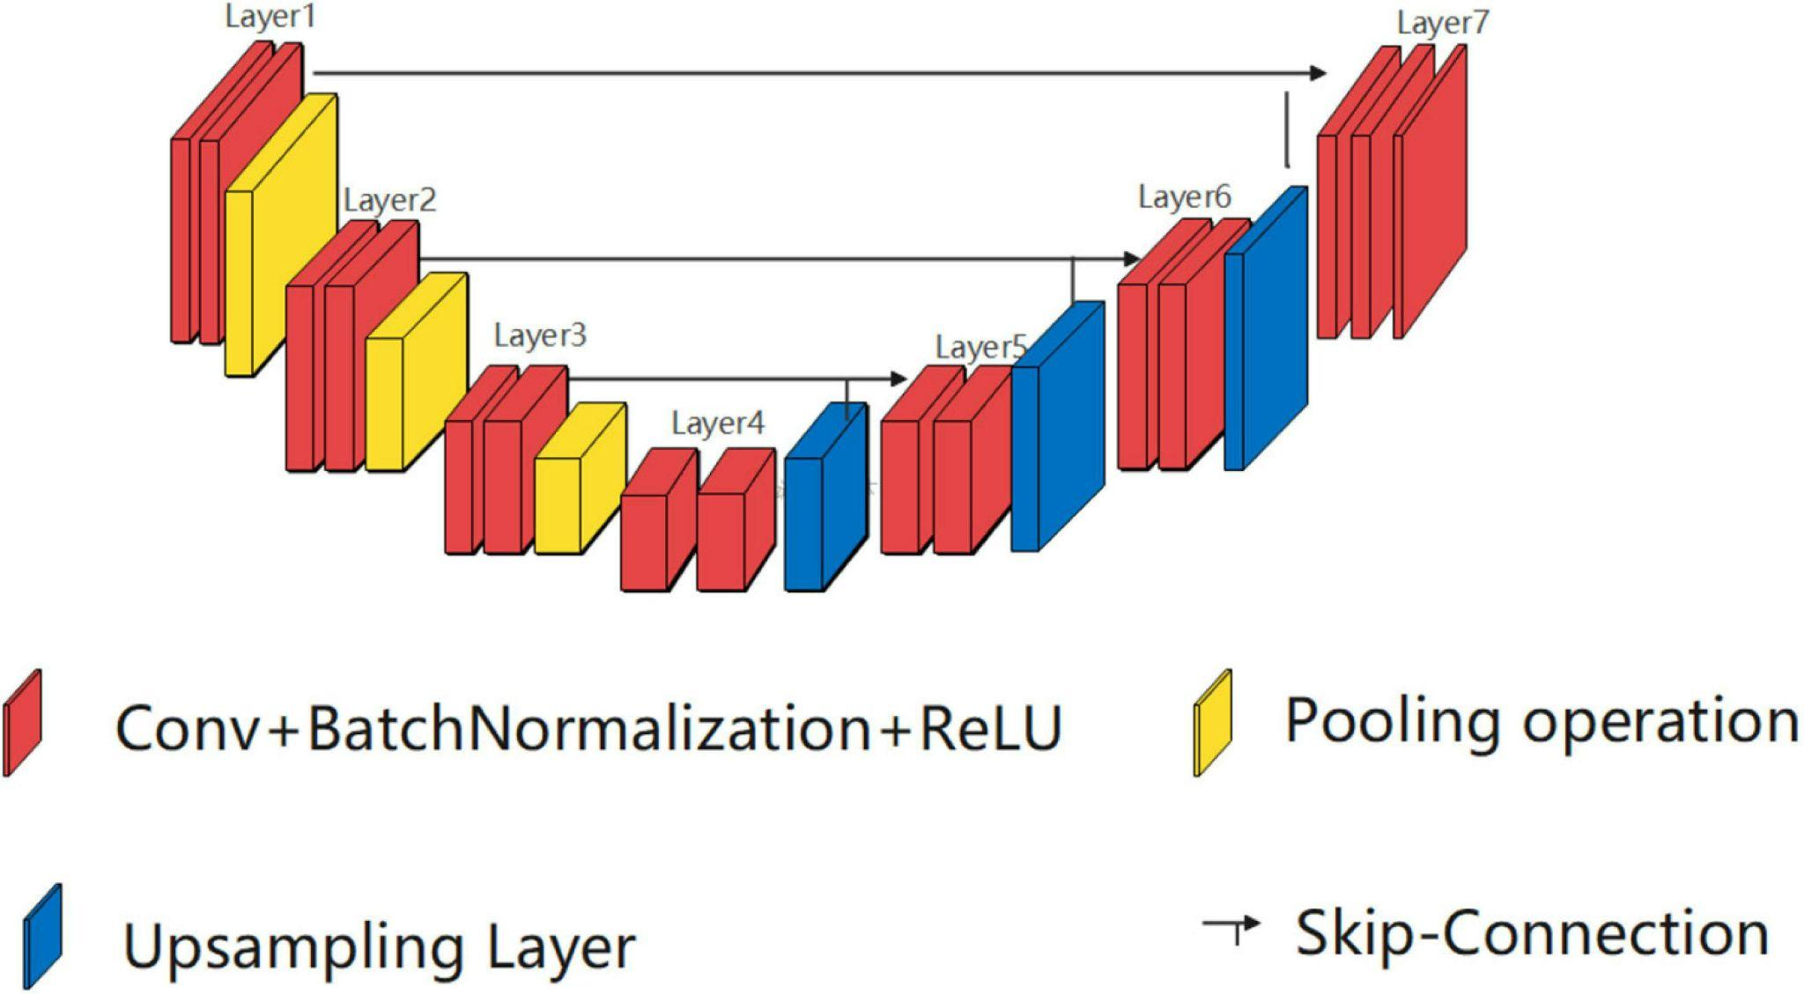
UNET ARCHITECTURE
UNet Architecture

Slide 10
Model 2 : RESUNET ARCHITECTURE
ResUNet is a modified version of the UNet architecture.
ResUNet incorporates residual connections, which allow the model to learn more effectively and improve the accuracy of segmentation results.
Used LGG-MRI dataset, 1167 training and 206 testing images
Model was trained for 75 epochs .
Batch size of 32.
Learning Rate of 0.05.

Slide 11
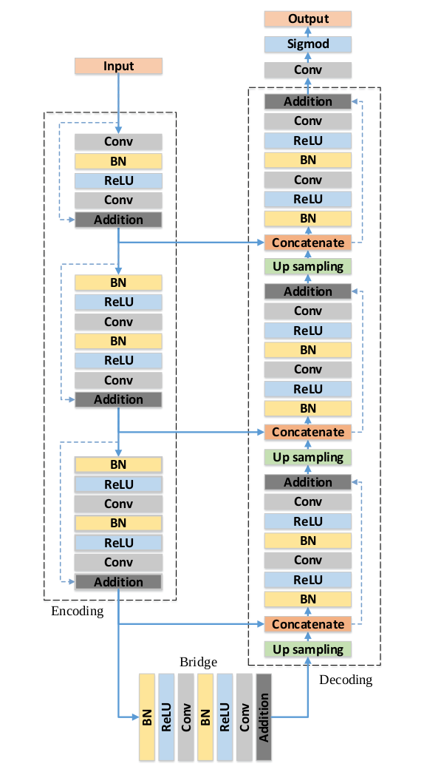
RESUNET ARCHITECTURE
ResUNet Architecture

Slide 12
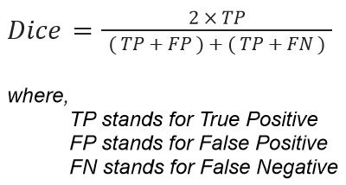
Evaluation metrics:
DICE SCORE
It measures the similarity between the two masks, with a value of 1 indicating a perfect match between the two masks.
It accounts for both true positives and false positives, which is helpful in datasets with an uneven ratio of background to foreground pixels. In these circumstances, identifying all pixels as background may yield a high accuracy, but the Dice Score will penalise such a prediction because it misses the foreground objects.

Slide 13
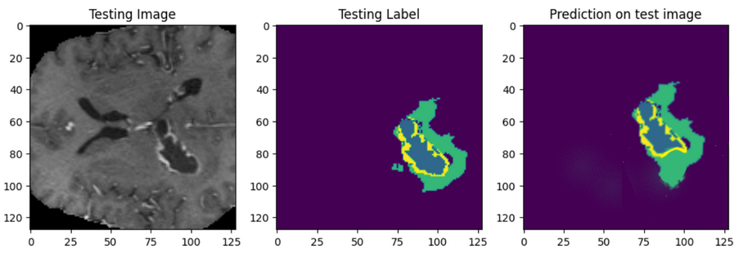
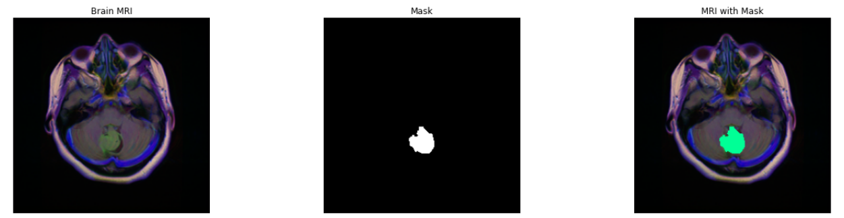
Observations:
Model 1: UNET ARCHITECTURE
Model 2: RESUNET ARCHITECTURE

Slide 14
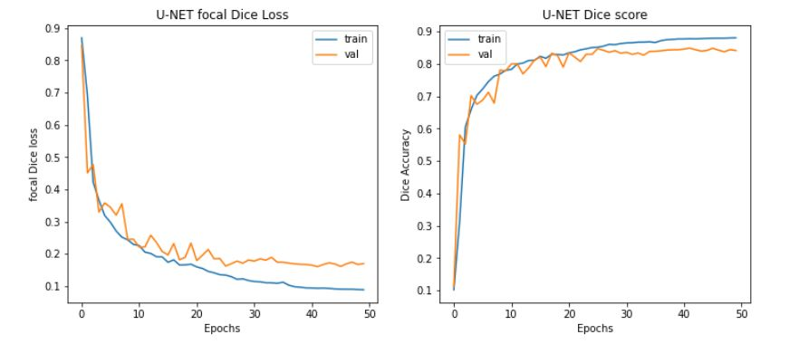
Model 1 : UNET ARCHITECTURE
Dice Score: 0.82
Dice Loss curve of UNet
Dice Score curve of UNet

Slide 15
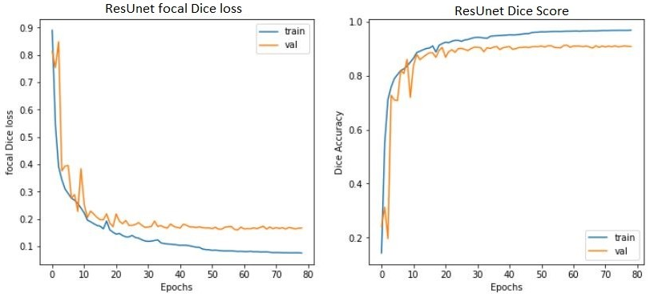
Model 2 : RESUNET ARCHITECTURE
Dice Score: 0.86
Dice Loss Curve of ResUNet
Dice Score curve of ResUNet

Slide 16
Conclusion:
We developed two models for brain tumor segmentation: one using UNet and another using ResUNet. The BraTS 2020 dataset was used for Model 1, while the LGG-MRI Segmentation dataset was used for Model 2.
The models were implemented and achieved promising results with dice scores of 0.82 and 0.86, respectively.
This indicate the potential of these models to assist medical professionals in accurate tumor detection and diagnosis.

Slide 17
Future Work:
Incorporating attention mechanisms to improve the segmentation accuracy.
Evaluating the models on a larger dataset with a greater variety of tumor types to ensure the generalization of the models.
Investigating the potential of using multi-modal imaging data such as MRI, CT and PET scans to improve the accuracy of segmentation.

Slide 18
Technology used:
Modules and libraries used:
Python
Kaggle
Jupyter Notebook
HPC
We used following python libraries:
Numpy
Pandas
Matplotlib
Seaborn
Sklearn
Tensorflow
Keras

Slide 19
References:
[1] Maji, D., Sigedar, P., & Singh, M. (2022). Attention Res-UNet with Guided Decoder for semantic segmentation of brain tumors. Biomedical Signal Processing and Control, 71, 103077.
[2] Li, S., Liu, J., & Song, Z. (2022). Brain tumor segmentation based on region of interest-aided localization and segmentation U-Net. International Journal of Machine Learning and Cybernetics, 13(9), 2435-2445.
[3] Das, S., Swain, M. K., Nayak, G. K., Saxena, S., & Satpathy, S. C. (2022). Effect of learning parameters on the performance of U-Net Model in segmentation of Brain tumor. Multimedia Tools and Applications, 81(24), 34717-34735.
[4] Ghosh, S., Chaki, A., & Santosh, K. C. (2021). Improved U-Net architecture with VGG-16 for brain tumor segmentation. Physical and Engineering Sciences in Medicine, 44(3), 703-712.
[5] Aghalari, M., Aghagolzadeh, A., & Ezoji, M. (2021). Brain tumor image segmentation via asymmetric/symmetric UNet based on two-pathway-residual blocks. Biomedical Signal Processing and Control, 69, 102841.
[6] Al Nasim, M.A., Al Munem, A., Islam, M., Palash, M.A.H., Haque, M.M.A. and Shah, F.M., 2022, December. Brain Tumor Segmentation using Enhanced U-Net Model with Empirical Analysis. In 2022 25th International Conference on Computer and Information Technology (ICCIT) (pp. 1027-1032). IEEE.

